Slide 1


Variable Length
Source Coding
Name：Abid Ali
Student ID:2023280099
Date：12-21-23

Slide 2

Types of Coding
Source Coding - Code data to more efficiently represent the information
– Reduces “size” of data
– Analog-Encode analog source data into a binary format
– Digital-Reduce the “size” of digital source data
Channel Coding – Code data for transmition over a noisy communication channel
– Increases “size” of data
–Digital-add redundancy to identify and correct errors
–Analog-represent digital values by analog signals

Slide 3
Types of Coding (Cont.)
Source Coding
Information sources may be analog or discrete (digital) •
- Analog sources: Audio or video •
- Discrete sources: Computers, storage devices such as magnetic or optical devices •
Whatever the nature of the information sources, digital communication systems are designed to transmit information in digital form •
Thus the output of sources must be converted into a format that can be transmitted digitally

Slide 4
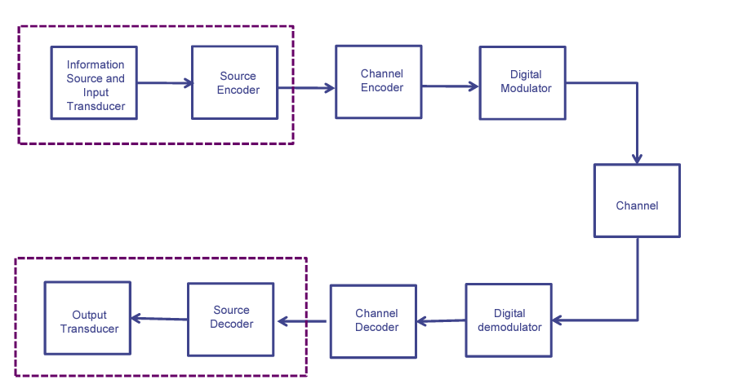
Source Coding
Source Coding
Fig : Functional block diagram of a typical digital communication system

Slide 5
Source Coding (Cont.)
Source Coding
This conversion is generally performed by the source encoder, whose output may generally assumed to be a sequence of binary digits
Encoding is based on mathematical models of information sources and the quantitative measure of information emitted by a source
We shall first develop mathematical models for information sources

Slide 6
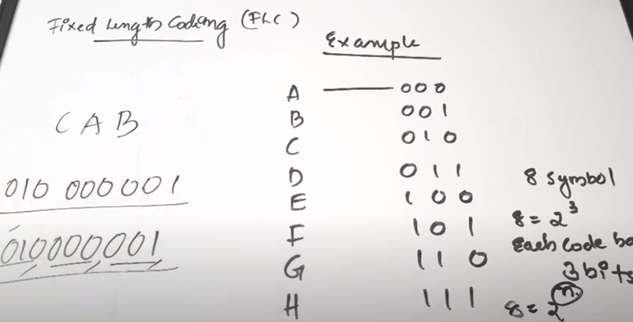
Nature of Code Lengths
Fixed Length Coding(FLC) and 2) Variable Length Coding
Variable-length code

Slide 7
Nature of Code Lengths (Cont)
Variable-length code
Variable-length codes can allow sources to be compressed and decompressed with zero error (lossless data compression) and still be read back symbol by symbol.
This is in contrast to fixed-length coding methods, for which data compression is only possible for large blocks of data, and any compression beyond the logarithm of the total number of possibilities comes with a finite (though perhaps arbitrarily small) probability of failure.
Some examples of well-known variable-length coding strategies are Huffman coding, and arithmetic coding,

Slide 8
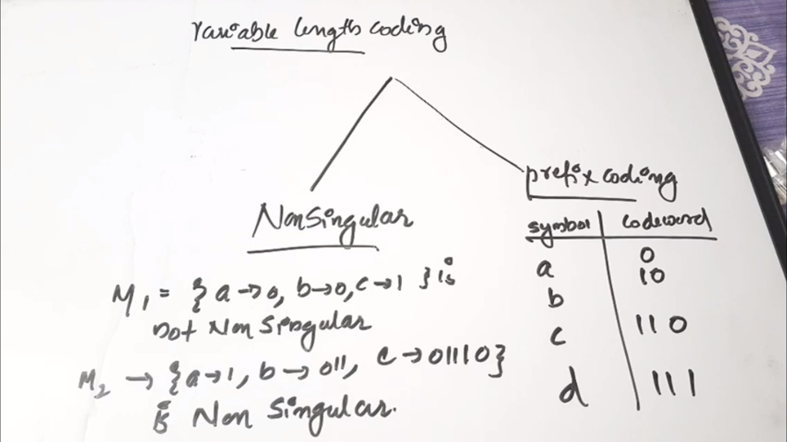
Nature of Code Lengths (Cont)
Variable-length code

Slide 9
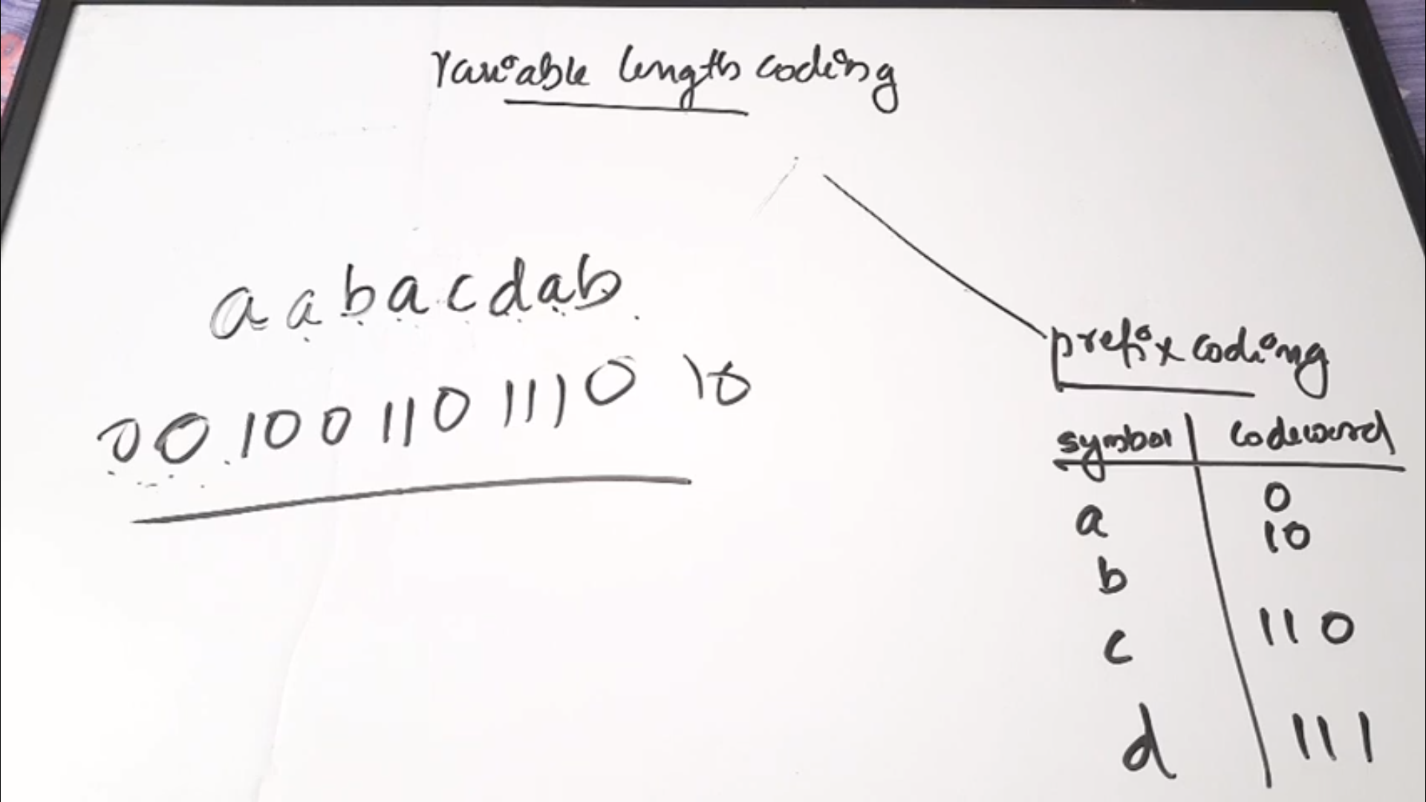
Nature of Code Lengths (Cont)
Variable-length code

Slide 10
Unique Decoding
The first property that we need is unique decodability - the received message must have a single, unique possible interpretation. Consider a code in which the source alphabet S has four symbols, and they are to be encoded in binary as follows:
s1 = 0
s2 = 01
s3 = 11
s4 = 00
The particular received message 0011 could be one of these two:
0011= s4, s3 or s1, s1, s3
thus the code is not uniquely decodable. While this property of unique decodability is not always absolutely essential, it is usually highly desirable.

Slide 11
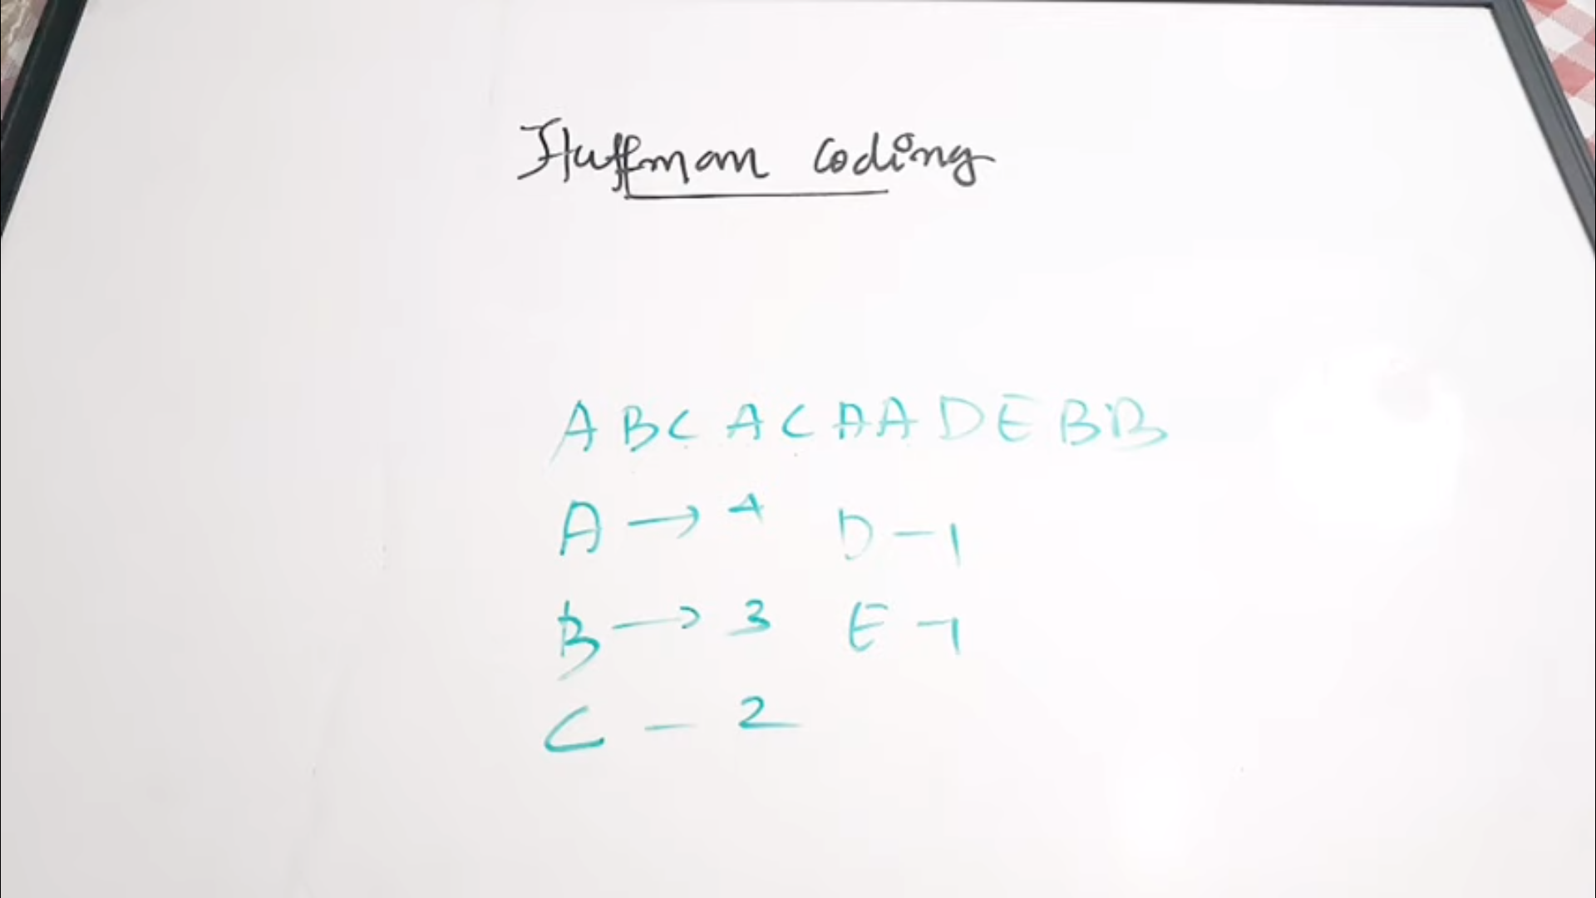
Huffman Coding
In computer science and information theory, a Huffman code is a particular type of optimal prefix code that is commonly used for lossless data compression. The process of finding or using such a code is Huffman coding, an algorithm developed by David A. Huffman
In Sano-fano coding probability was used but in Huffman Coding which is looking frequency of appearance of symbols.

Slide 12
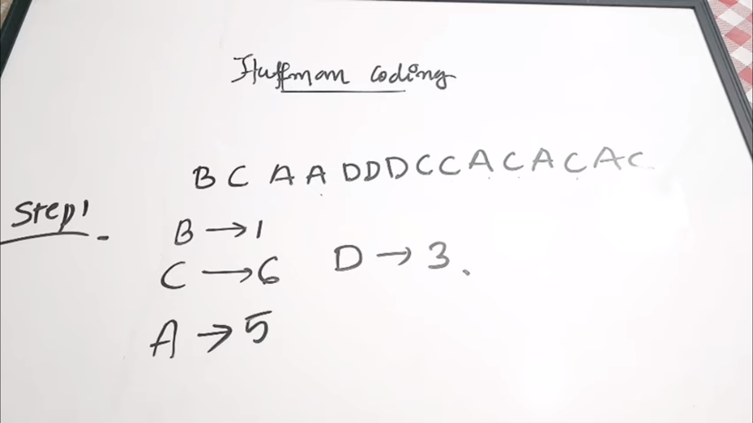
Huffman Coding
If a symbol is appearing more frequently then we will give short code word
If a symbol is appearing less frequently then we will give lengthy code word

Slide 13
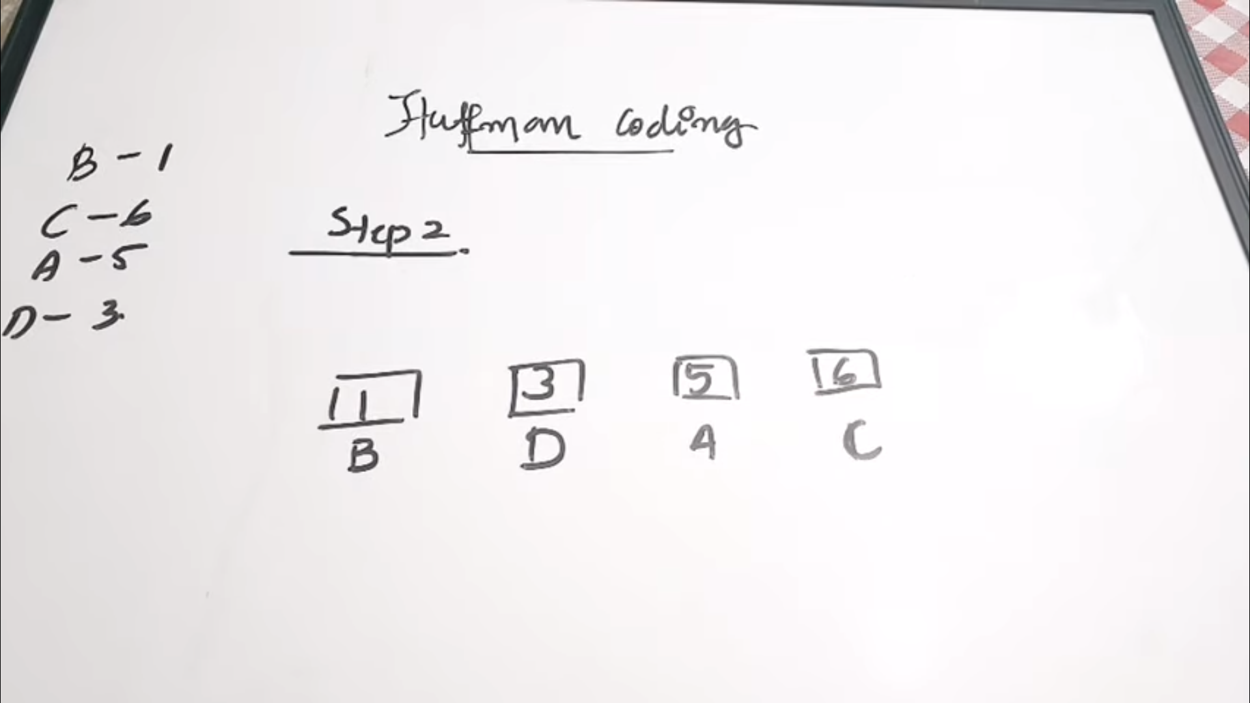
Huffman Coding
Arrange the frequencies in ascending order

Slide 14
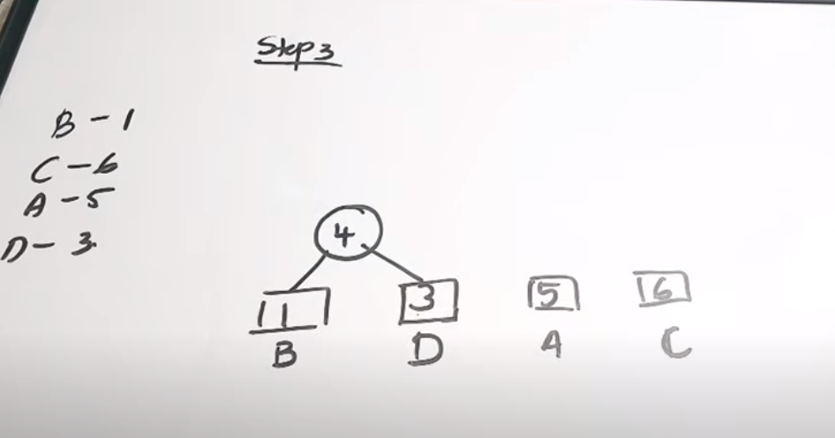
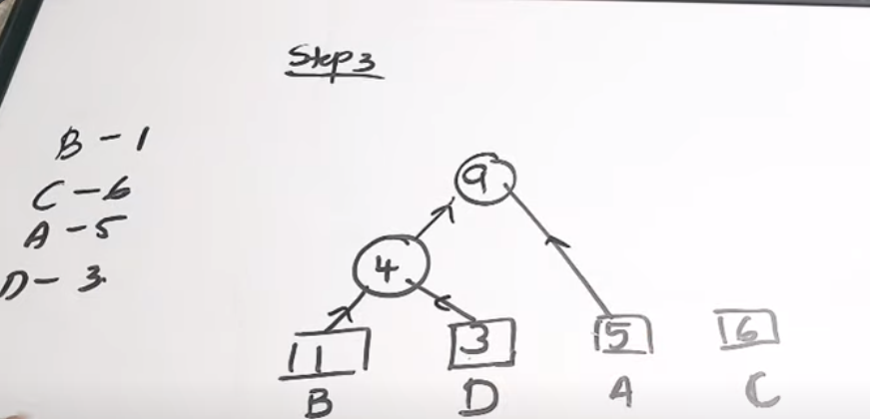
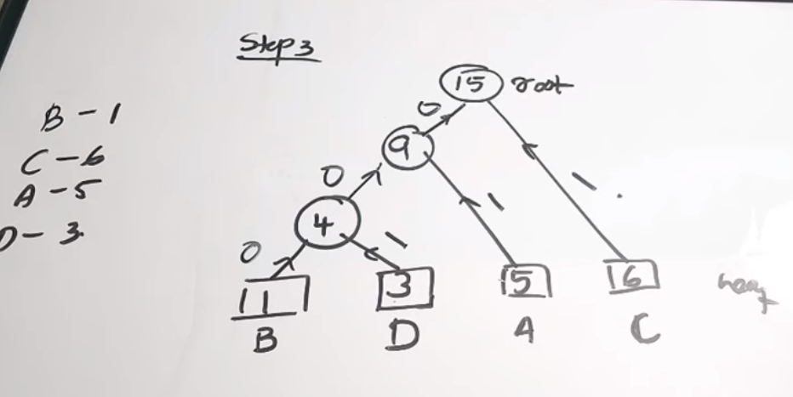
Huffman Coding
Merge the two lowest frequency

Slide 15
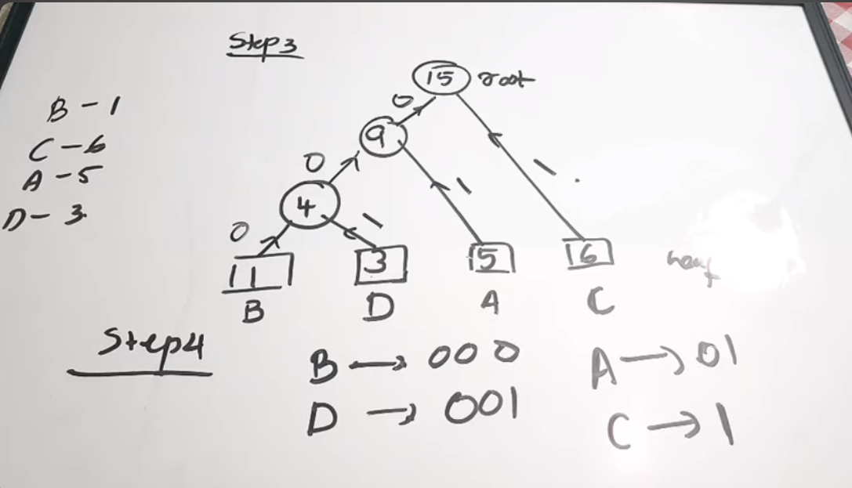
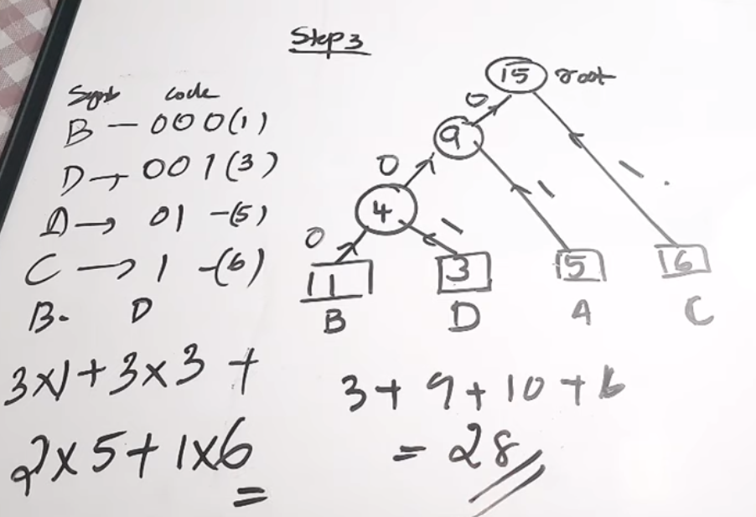
Huffman Coding

Slide 16
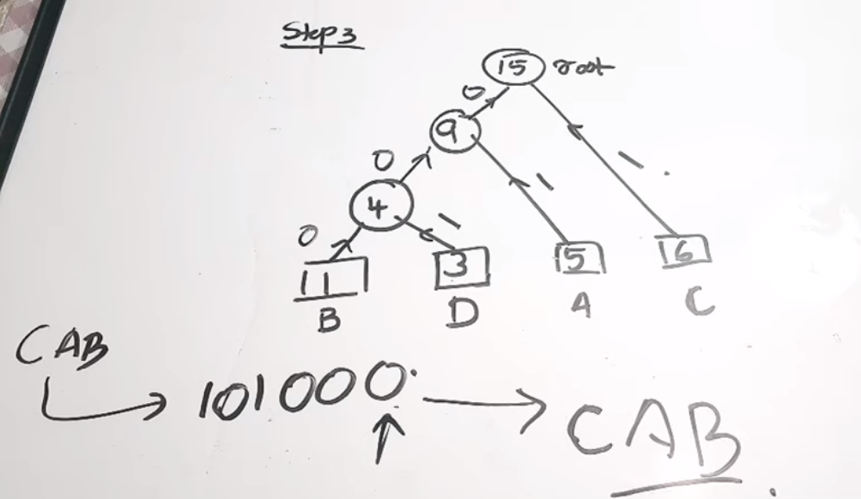
Huffman Coding
Decoding Huffman Coding

Slide 17
Conclusion
# Fixed-length codes are usually easier to deal with because both the coder and decoder know in advance how many bits are involved, and it is only a matter of setting or reading the values.
# Variable-length codes, the decoder needs a way to determine when the code for one symbol ends and the next one begins.
# Almost every processor uses variable length instructions. Some instructions have no address arguments, some need one address, some need two.
# Fixed length instructions may be easier to parse but in general waste space.

Slide 18
References
# Online teacher’s lecture
# YouTube video
# ChapGPT

Slide 19


Thanks
Abid Ali
2023280099

